Slide 1
Bienvenue

Slide 2
Shortly after you enter class, I will ask for your attention. I will expect…
To see every student sitting in a chair ready to learn.
Absolute silence throughout the room when I ask for your attention.
Every student with the proper materials for learning.
Student journals open to the next available page.

Slide 4
Welcome to another school year:
I would appreciate being addressed as Mr. Bellis.
I am looking forward to teaching this year’s curriculum. I hope that we can build a community, incorporating all the students and staff at DHS.
“Where one goes, we all go.”

Slide 5
Outside of the classroom…
I go to workshops, conferences, in-service meetings, college classes, and seminars.
I also read professional journals and work together with my fellow teachers.
As an Earth Scientist I have conducted mathematics based research.
I am telling you this to let you know that I am up to date as a professional.

Slide 6
You are going to have one of the greatest educational experiences of your life this year. You will meet new friends, explore amazing concepts, stand up in front of your peers, conduct your own research, play games, and experience success. Welcome to our classroom, and I look forward to getting to know you more.
Sincerely,
Mr. Bellis

Slide 7
My Responsibilities
To treat you with care and respect.
To provide you with an orderly classroom.
To provide you the necessary discipline.
To teach you the required content.
To provide the appropriate motivation.
My

Slide 8
Which of the pictures below looks like what our classroom should look like?

Slide 9
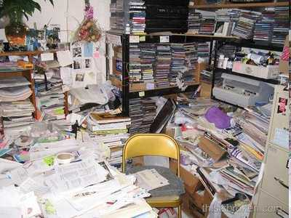
Which of the pictures below looks like what our classroom should look like?
A

Slide 10
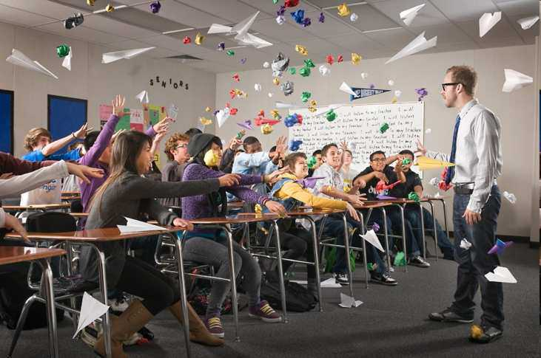
Which of the pictures below looks like what our classroom should look like?
A
B

Slide 11
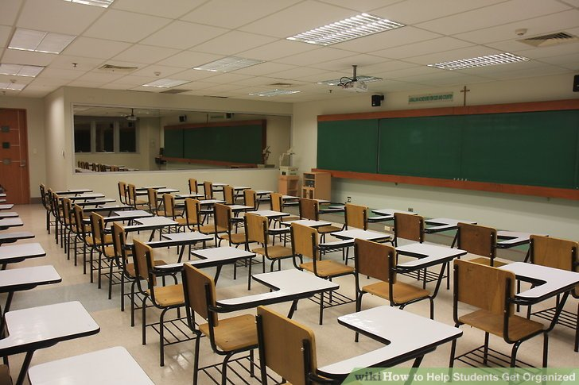
Which of the pictures below looks like what our classroom should look like?
A
B
C

Slide 12
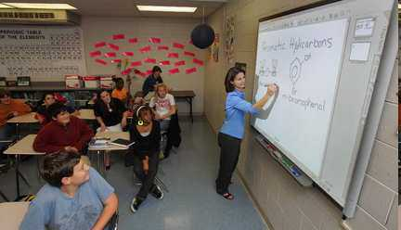
Which of the pictures below looks like what our classroom should look like? Answer…
A
B
C
D

Slide 13
Which of the pictures below looks like what our classroom should look like? Answer…
A
B
Our room should be clean and organized at all times.
C
D

Slide 14
Which of the pictures below looks like what our classroom should look like? Answer…
B
C
D

Slide 15
Which of the pictures below looks like what our classroom should look like? Answer…
B
You will need to show me respect at all times.
C
D

Slide 16
Which of the pictures below looks like what our classroom should look like? Answer…
C
D

Slide 17
Which of the pictures below looks like what our classroom should look like? Answer…
C
D
Where is everyone?

Slide 18
Which of the pictures below looks like what our classroom should look like? Answer…
D

Slide 19
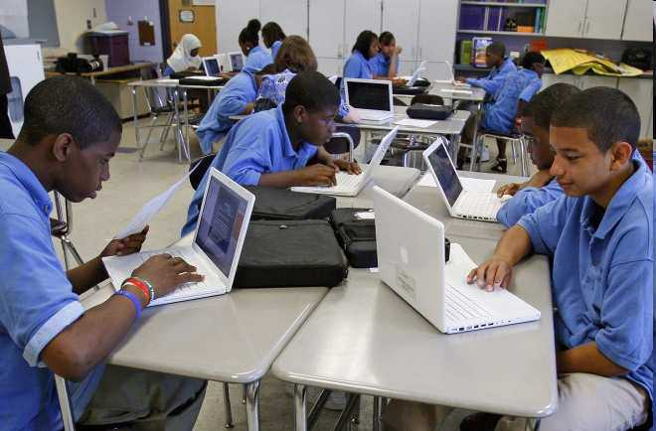
Your Responsibilities
To treat me and others with care and respect.
To attend classes regularly.
To be cooperative and not disruptive.
To study and do your best (effort = success)
To learn and master the required content.

Slide 20
Activity! What 3-5 items should you bring to class from the pictures below?
A
B
C
D
G
H
E
F
I
J
K

Slide 21
Activity! What 3-5 items should you bring to class from the pictures below?
A
B
C
D
G
H
E
F
I
J
K

Slide 22
Activity! What 3-5 items should you bring to class from the pictures below?
B
C
D
G
H
E
F
I
J
K

Slide 23
Activity! What 3-5 items should you bring to class from the pictures below?
B
C
D
G
H
E
F
I
J
K

Slide 24
Activity! What 3-5 items should you bring to class from the pictures below?
B
C
D
G
H
E
F
I
J
K

Slide 25
Activity! What 3-5 items should you bring to class from the pictures below?
B
D
G
H
E
F
I
J
K

Slide 26
Activity! What 3-5 items should you bring to class from the pictures below?
B
D
G
H
E
F
I
J
K

Slide 27
Activity! What 3-5 items should you bring to class from the pictures below?
B
D
G
H
E
F
I
J
K

Slide 28
Activity! What 3-5 items should you bring to class from the pictures below?
B
D
G
H
E
F
I
J
K

Slide 29
Activity! What 3-5 items should you bring to class from the pictures below?
B
D
G
H
E
F
I
J
K

Slide 30
Activity! What 3-5 items should you bring to class from the pictures below?
B
D
G
H
E
F
I
J
K

Slide 31
Activity! What 3-5 items should you bring to class from the pictures below?
B
D
G
H
E
I
J
K

Slide 32
Activity! What 3-5 items should you bring to class from the pictures below?
B
D
G
H
E
I
J
K

Slide 33
Activity! What 3-5 items should you bring to class from the pictures below?
B
D
H
E
I
J
K

Slide 34
Activity! What 3-5 items should you bring to class from the pictures below?
B
D
H
E
I
J
K

Slide 35
Activity! What 3-5 items should you bring to class from the pictures below?
B
D
E
I
J
K

Slide 36
Activity! What 3-5 items should you bring to class from the pictures below?
B
D
E
I
J
K

Slide 37
Activity! What 3-5 items should you bring to class from the pictures below?
B
D
E
I
J
K

Slide 38
Activity! What 3-5 items should you bring to class from the pictures below?
B
D
E
I
J
K

Slide 39
Activity! What 3-5 items should you bring to class from the pictures below?
B
D
E
I
K

Slide 40
Activity! What 3-5 items should you bring to class from the pictures below?
B
D
E
Which three are most important?
I
K

Slide 41
Activity! What 3-5 items should you bring to class from the pictures below?
D
Which three are most important?
I
K

Slide 42
What does it mean to come to class prepared ?
You will need to arrive on time with…

Slide 43
What does it mean to come to class prepared ?
You will need to arrive on time with…
Textbook
Organizer including paper
Math Journal
Pens and pencils (tool-kit)

Slide 44
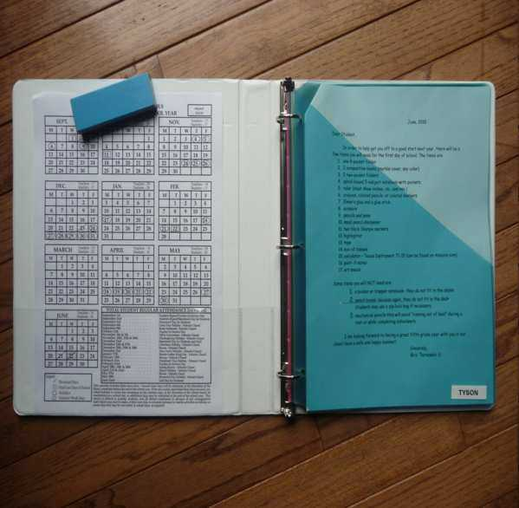
Staying Organized
I expect you to save all your handouts, tests, and assignments throughout the year.
The easiest and neatest way to do this is in a binder.

Slide 45
At the beginning of class…
Come into class and take your seat.
Pull out your math journal and open it to the first available page.
Sharpen your pencil before class begins.

Slide 46
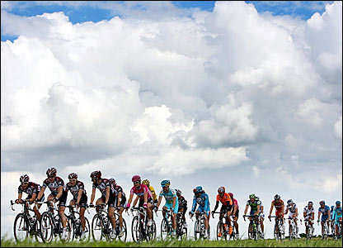
A strong start to class = A good class for everyone.

Slide 47
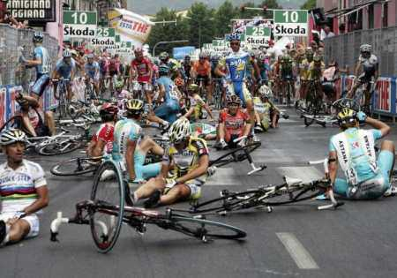
A poor start of class = A weaker class.

Slide 49
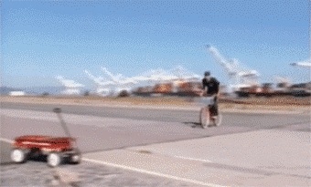
A poor start of class = A weaker class.
But let’s not rush

Slide 50
Is this picture an example of students cheating?

Slide 51
Is this picture an example of students cheating?
No, the students are working together and helping each other.

Slide 52
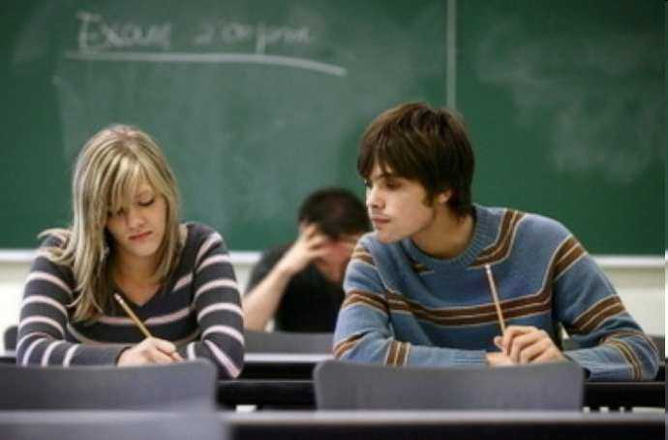
Is this picture an example of a student cheating?

Slide 53
Is this picture an example of a student cheating?
Yes, This student will definitely be in trouble. Cheating isn’t worth it. It only cheats you of your opportunity to shine.
Come and see me, I’m here to help you.

Slide 54
You can teach by…
Showing someone how to get the right answer.
Provide, and walk students through examples.
Allow students to attempt the work.
Help is always a question away.
Verbalize / summarize the answer.

Slide 55
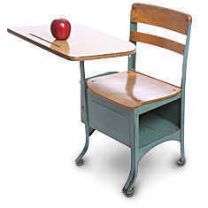
If you are absent...BE PROACTIVE!
See me when you get back, I won’t find you.
Get the notes from a friend.
If you know you will be missing school, see me before you are absent.

Slide 56
Please guess the mystery street below as I slowly remove the boxes.
Raise your hand when you think you know.

Slide 57
Please guess the mystery street below as I slowly remove the boxes.
Raise your hand when you think you know.

Slide 58
Please guess the mystery street below as I slowly remove the boxes.
Raise your hand when you think you know.

Slide 59
Please guess the mystery street below as I slowly remove the boxes.
Raise your hand when you think you know.

Slide 60
Please guess the mystery street below as I slowly remove the boxes.
Raise your hand when you think you know.

Slide 61
It’s Positive.
This year is your opportunity to be positive.

Slide 62
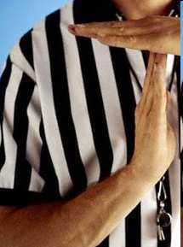
A few ground rules that need to be followed along with the school code.
Don’t shout out, please raise your hand.
One speaker at a time.
No cross-room conversations.
Movement with a purpose (academic).
Clean up after yourself and others.

Slide 63
Which one of the following is not an actual ground rule?
A.) Don’t shout out, please raise your hand.
B.) One speaker at a time.
C.) No talking.
C.) No cross-room conversations.
D.) Movement with a purpose (academic).
E.) Clean up after yourself and others.

Slide 64
Which one of the following is not an actual ground rule?
A.) Don’t shout out, please raise your hand.
B.) One speaker at a time.
C.) No talking.
C.) No cross-room conversations.
D.) Movement with a purpose (academic).
E.) Clean up after yourself and others.

Slide 65
Which one of the following is not an actual ground rule?
A.) Don’t shout out, please raise your hand.
B.) One speaker at a time.
C.) No talking.
C.) No cross-room conservations ever.
D.) Movement with a purpose (academic).
E.) Clean up after yourself and others.
“We need to talk in order to learn this year.”
“Discussion needs structure.”

Slide 66
Discipline and Class Rules
All school wide expectations carry over into every classroom.
We will be focusing on the philosophy “If you break it, fix it,” as a logical consequence to students who have difficulties with school policies.

Slide 67
Why You Will Succeed

Slide 68
Why You Will Succeed
What is taught in this class is important.
I believe in you.
You can Do it.
Never Give Up!

Slide 69
Try and figure out the picture beneath the boxes.
Raise your hand when you know. You only get one guess.
Copyright © 2010 Ryan P. Murphy

